Slide 1
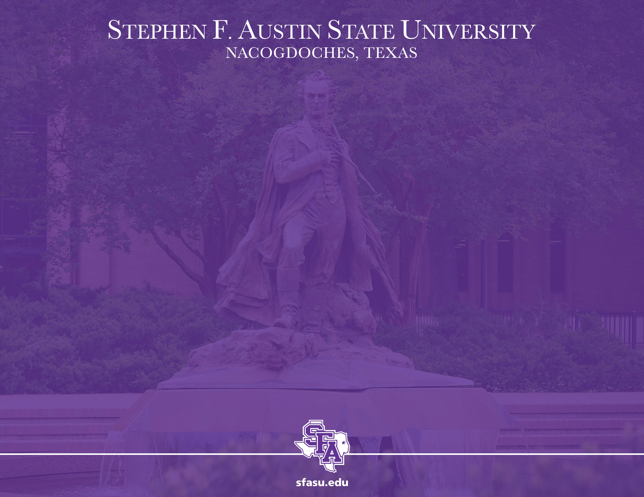
Intro to Python
MTH 564 – Mathematical Modeling

Slide 2

Installation of Python
Overview of Python
Python is. . .
Free and open source
It is a scripting language - an interpreted not a compiled language
It is object oriented with modern exception handling, dynamic typing etc.
It has plenty of libraries among others the scientific ones: linear algebra; visualization tools: plotting, image analysis; differential equations solving; symbolic computations; statistics ; etc.
It has possible usages: scientific computing, scripting, web sites, text parsing, data mining, ...

Slide 3
Installation of Python
Interpreted vs. Compiled
Interpreter | Compiler
Translates program one statement at a time. | Scans the entire program and translates it as a whole into machine code.
Less time to analyze source code but the overall execution time is slower. | Takes large amount of time to analyze the source code but overall execution time is comparatively faster.
No intermediate object code is generated, making it more memory efficient. | Generates intermediate object code which further requires linking, hence requires more memory.
Debugging is Easy: Translates the program until first error is met, then stops. | Debugging is Harder: Generates the error message only after scanning whole program.
Ex. Python, Ruby use interpreters. | Ex. C, C++ use compilers.

Slide 4
Object Oriented Programming (OOP)
OOP is a programming model where programs are organized around objects and data rather than action and logic. OOP allows decomposition of a problem into a number of entities called objects and then builds data and functions around these objects.
The software is divided into a number of small units called objects. The data and functions are built around these objects.
The data of the objects can be accessed only by the functions of that object.
The functions of one object can access the functions of another object.
Ex. Object: Car
Data (Fields): Model, Year, Color
Functions: Start, Stop, Accelerate, Brake

Slide 5
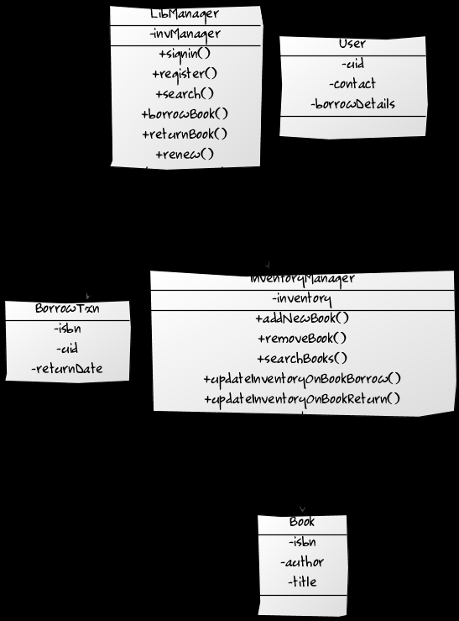
Example: Library
Object: Book
Fields
Methods
Object: User
Fields
Methods
Object: Librarian
Fields
Methods

Slide 6
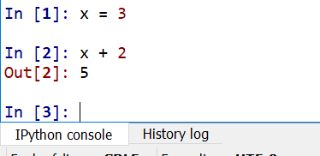
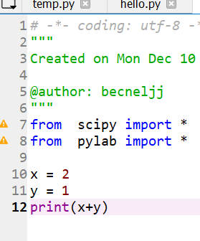
Interactive vs. Scripting
Python can use in two ways: Scripting and Interactive
Interactive
Executes statements one at a time
Using the IPython shell
Good for short task
The prompt string counts the statements
Press Up ↑ or ↓ to scroll through commands
Type command? to get help: e.g. In[1]: print?
Scripting
Executes a file full of statements
Uses the text editor
Run all the commands sequentially using the green arrow

Slide 7
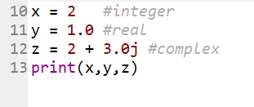

Datatypes
Numbers
Integers – don’t have a decimal
Real Numbers (floating point) – have a decimal
Complex Numbers – typically have a j in them, where
$$j=\sqrt{−1}$$

Slide 8
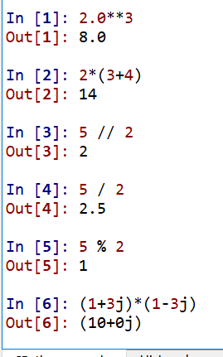
Datatypes
Operations On Numbers
+ and - addition and subtraction
* and / multiplication and division
** power
// integer division
% modulus (remainder of integer division)

Slide 9


Datatypes
Strings
Used for Text
Basically a list of characters
Must be inside either single quotes ‘ ‘ or double quotes “ “

Slide 10
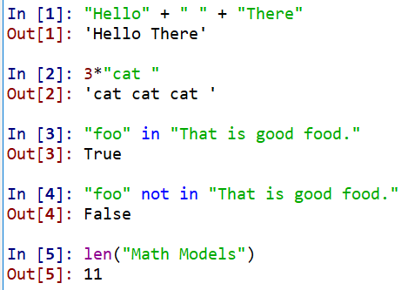
Datatypes
Operations On Strings
+ concatenates strings
* multiple copies of a string
in True/False if one string is in another string
not in True/False if one string is not in another string
len( ) length of a string

Slide 11
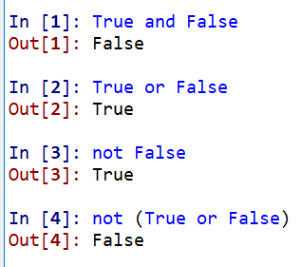
Datatypes
Boolean
Only two values: True False
Used for logical statements
Boolean Operators
and – true if both operands are true
or – true if either (or both) of the operands are true
not – true if operand is False

Slide 12

Variables
Variables
used to reference a stored value within the computer’s memory
variables are not declared
the datatype (or type) of variable can change after it is created
Variables are assigned a value with =

Slide 13
Variables
Rules for Naming Python Variables:
must start with a letter or the underscore character
cannot start with a number
can only contain alpha-numeric characters and underscores (A-z, 0-9, and _ )
variable names are case-sensitive (age, Age and AGE are three different variables)
Valid | Invalid | Why Invalid
my_int | my-int | Hyphens are not permitted
int4 | 4int | Cannot begin with a number
MY_INT | $MY_INT | Cannot use symbols other than _
another_int | another int | Cannot be more than one word

Slide 14
Variables
Naming Conventions:
these are not “rules” but agreed upon standards.
Convention: lowercase with words separated by underscores _
use a leading _ to tell people not to mess with a variable, e.g. _dog
VARIABLES NAMES SHOULD BE DESCRIPTIVE AND HELPFUL!!!!!!!!!!
Conventional | Unconventional | Why Unconventional
my_int | myInt | camelCase not conventional
int4 | Int4 | Upper-case first letter not conventional
my_first_string | MyFirstString | Starting capital is not conventional

Slide 15
Constants
Constants:
basically they are variables but we NEVER change their value.
Naming Convention: all UPPERCASE with words separated by underscores _
CONSTANT NAMES SHOULD BE DESCRIPTIVE AND HELPFUL!!!!!!!!!!
Example: freefall.py

Slide 16
Comments
Comments:
parts of file that are ignored by Python
these are used to help YOU and others understand what is happening in the code
start with the # character and extend to the end of the line
COMMENTS ARE IMPORTANT AND NECESSARY
you typically have more comments than lines of code
Doc Strings – similar to comments but can span multiple lines
start and end with triple quotes “””
Typically used at the start of the file and after modules, classes, functions, or methods

Slide 17
Conditionals
Python supports the usual logical conditions from mathematics:
Equals: a == b
Not Equals: a != b
Less than: a < b
Less than or equal to: a <= b
Greater than: a > b
Greater than or equal to: a >= b
These return True or False based on the evaluation.

Slide 18
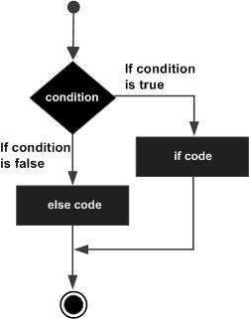
If-Then-Else Statements
if boolean_expression:
true-statement1
true-statement2
….
else:
false-statement1
false-statement2
…..
Note colon : symbols and indentation are very important

Slide 19
If-Then-Else Statements
if boolean_expression_1:
statements…
elif Boolean_expression_2:
statements…
else:
statements..
Example: lettergrade.py

